Slide 1
Working with Disks and Devices
Lesson 4

Slide 2
Objectives
Describe MBR and GPT partition styles
Describe basic and dynamic disks
Describe the 4 types of dynamic volumes
Use the Disk Management snap-in to manage disks
Create Virtual Hard Disks (VHDs)
Describe the purpose of a Device Driver
Use the Device Manager snap-in to manage your hardware
Notes:
Outline the material you are going to cover in this lesson. Do not go into detail as each of these points will be expanded on in the lesson. You may also want to mention the Technology Skills that are being covered for the Certification exam also.

Slide 3
Working with Disks
Select a partition style
Select a disk type
Divide the disk into partitions or volumes
Format with a file system
Notes:
Introduce the different tasks involved when Working with Disks. Explain that the installation process handles most of this for you initially, but adding disks to a system is a common task, post installation.

Slide 4
Understanding Partition Styles
MBR – Master Boot Record
GPT – GUID (globally unique identifier) Partition Table
Notes:
Introduce the partition styles. Which OS’s support each one. Don’t go through details here. Use the chart on the next slide.

Slide 5
Partition Style Comparison
MBR
GPT
Supports up to 4 primary partitions, or 3 primary and an extended
Supports volumes up to 2 terabytes
Uses hidden sectors to store system information
Replication and CRC are NOT features of MBR’s partition table
Supports up to 128 primary partitions
Supports volumes up to 18 exabytes
Uses partitions to store system information
Replication and cyclical redundancy check (CRC) protection of the partition table for reliability
Notes:
Compare the different Partition Styles.

Slide 6
Disk Types – Basic Disk
Compatible with other versions of Windows
Consists of primary and extended partitions
Supports up to four partitions (per single hard drive)
Windows can only be installed on basic storage type partitions

Slide 7
Primary and Extended Partitions
PRIMARY
EXTENDED
Functions as a physically separate disk
Can host an OS
Can be marked as active (and used to boot from)
Up to 4 are supported or 3 + 1 extended
Each is formatted and assigned a drive letter
Cannot host an OS
Cannot be active partition
Basic disk can only host 1 Extended but unlimited logical partitions
Do not format extended partition, but only the logical drives
Notes:
Compare Primary and Extended partition properties and give examples of when you would use each. Discuss possible disk configurations.

Slide 8
Disk Types – Dynamic Disks
Supported by Windows 2000/XP/Vista/7
Can combine two or more physical disks into one dynamic disk
Are divided into volumes
Unlimited number of volumes
Not supported on:
  Portable computers
  Removable disks
  External USB or Firewire Drives
  Windows 7 Starter or Home editions

Slide 9
Volume Types
Simple volume
Spanned volume
Striped volume
Mirrored volume
Notes:
Introduce the 4 volume types. You can mention RAID 5, but note that Windows 7 doesn’t support it.

Slide 10
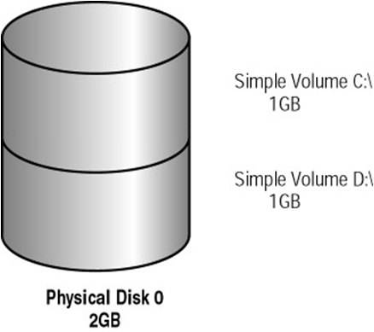
Dynamic Disk - Simple Volume
Contains space from a single dynamic drive

Slide 11
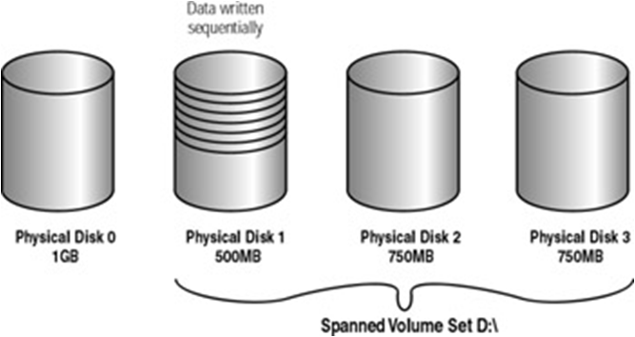
Dynamic Disk - Spanned Volume
Consists of disk space on 2 to 32 dynamic drives (any size)
Notes:
Explain Spanned Volume’s requirements and limitations. Make sure to mention that the areas of free space being combined can be any size. Explain how data is written to the areas of space within a spanned volume. Mention that there is no parity information stored in a spanned volume and that backups are important.

Slide 12
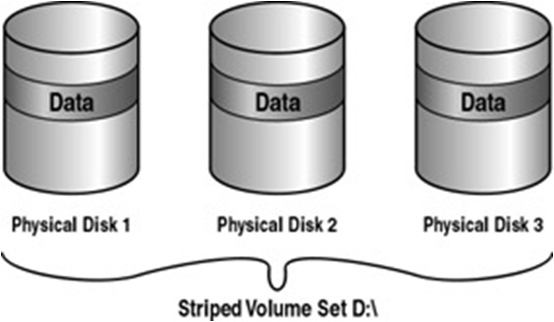
Dynamic Disk - Striped Volume
stores data in equal stripes on 2 - 32 dynamic drives (same size)
Notes:
Explain Striped Volume’s requirements and limitations. Make sure to mention that the areas of free space being combined must be the same size and there is no parity information.

Slide 13
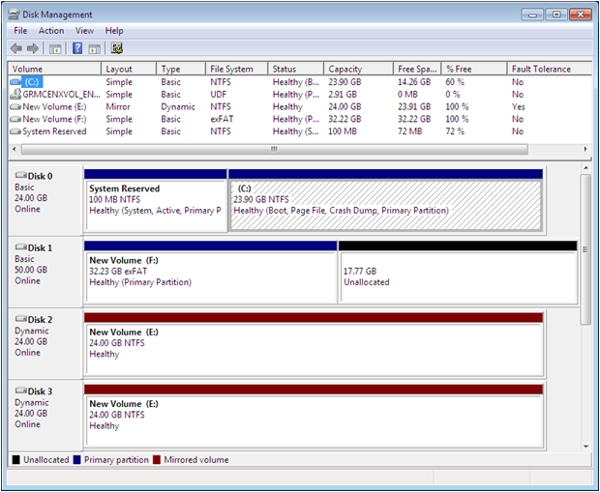
Dynamic Disk – Mirrored Volume
Notes:
Explain what the purpose of mirroring is and its requirements.

Slide 14
File Systems
NTFS
  Preferred file system for Windows 7
  Partitions up to 4 TB
  Security (encryption and permissions)
FAT (FAT16) – Partitions up to 4 GB
FAT32 – Partitions up to 32 GB (Windows 7 limitation)
exFAT (FAT64) – Intended for large USB drives, not hard drives
Notes:
Describe each file system, its limitations, and when you might use each one. Discuss the benefits of NTFS and why it is the preferred file system for Windows 7.

Slide 15
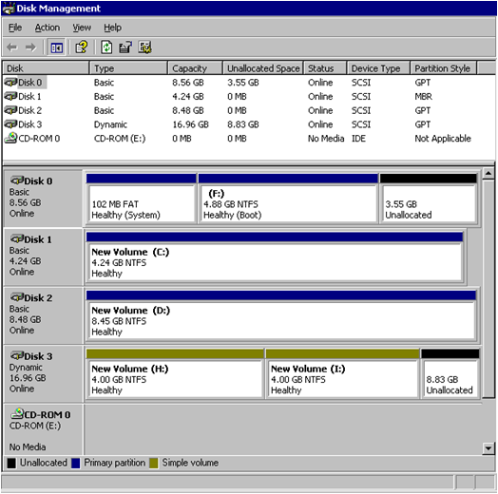
Disk Management Snap-In
Notes:
Describe the different views within the Disk Management tool. Point out where it shows the partition style of MBR or GPT, the Device Type, whether the disk is Basic or Dynamic, what File System is used. What the different types of Partitions or Volumes are. Explain that there are context-sensitive menus that will show you your options, depending on where you click. Demonstrate if possible.

Slide 16
Using the Disk Management Snap-In
Initializing disks
Selecting a partition style
Converting basic disks to dynamic disks
Creating partitions and volumes
Extending, shrinking, and deleting volumes
Notes:
Describe the different tasks you can perform with the Disk Management tool. Demonstrate if you can. Continued on next slide.

Slide 17
Using the Disk Management Snap-In (cont’d)
Formatting partitions and volumes
Assigning and changing driver letters and paths
Examining and managing physical disk properties such as disk quotas, folder sharing, and error checking

Slide 18
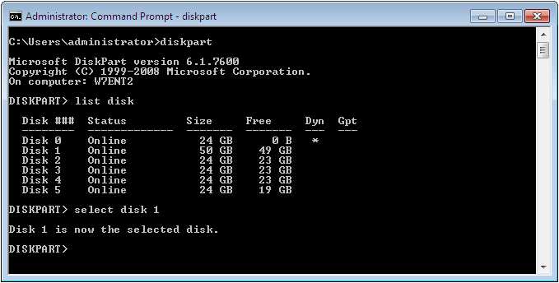
Diskpart.exe
Notes:
Explain that DiskPart is a command line tool which can be used to manage disks. It is more powerful than the Disk Management Snap in. You can do more and different tasks with it.

Slide 19
Using Disk Tools
Disk Cleanup
Defragmenting disks
Checking for disk errors
Notes:
Explain that these tools are available in the Disk Management Snap in, by using the context-sensitive menus. Describe each tool and when you need to use it.

Slide 20
Working with VHDS
Notes:
Introduce the topic of VHDs and what they are used for. Discussing the concept of virtual machines (Virtual PC, Virtual Server, and Hyper-V) might be useful to students who are not familiar with the concepts.

Slide 21
Virtual Hard Disk (VHD)
VHD file format
  Contains the entire contents of a hard disk in a single, portable file
  Can be used to move entire virtual machines (VMs) from one host computer to another
  VHD functions exactly like a hard disk drive does in a physical machine
  Can be created with Disk Management tool or Diskpart.exe
Notes:
Define VHD.

Slide 22
Other Uses for VHDs
Moving files between a VHD and the host file system
Backup and recovery
Antivirus and security
Image management and patching
Notes:
Describe some of the uses of VHDs.

Slide 23
Native Boot
Supported by Windows 7 Enterprise, Ultimate, and all versions of Windows Server 2008
Enables you to create and modify VHDs
Boot Windows 7 from a VHD without having to run a virtual machine manager
Notes:
Define Native Boot and what it allows you to do.

Slide 24
Advantages of Native Boot
Offline image updates
Image format
Image deployment testing
Workstation configuration management
Notes:
Describe each of these advantages using additional information from the textbook.

Slide 25
Attaching and Detaching VHDs
Creating a new VHD automatically mounts it into the Windows 7 file system
Mounting of a VHD is not persistent
  Each time you restart Windows 7, you must attach the VHD using the Disk Management snap-in before you can access its contents.
Notes:
Explain how before you can work with a VHD in Windows you must attach it to the file system. This is automatically done when you create a VHD through the Disk Management tool, but after every restart the VHD needs to be attached again.

Slide 26
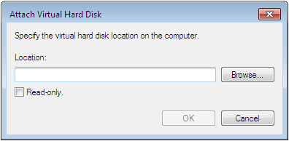
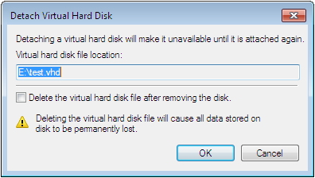
Attaching and Detaching VHDs
Notes:
Use the screen shots on the slide to show the screens for attaching and detaching VHDs if you are unable to demonstrate.

Slide 27
Booting from a VHD
Booting directly from a VHD is a new feature of Windows 7
Deploy an image to a VHD file just like to a physical disk
Add the VHD to the boot menu using BCDedit
Notes:
Review the deployment tools discussed in earlier lessons, such as ImageX.exe. Deploying an image to a VHD is the same as deploying to a physical disk on the computer. Use the information from the textbook to explain how to add a VHD to the boot menu.

Slide 28
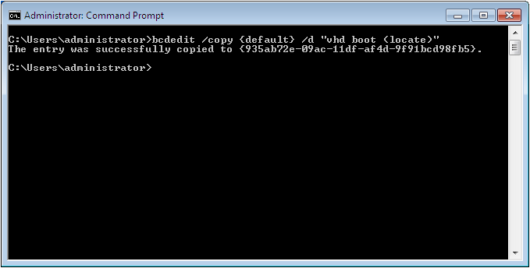
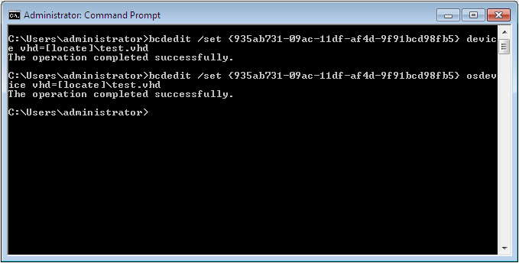
Using BCDedit to Add VHD to Boot Menu
Notes:
If you cannot demonstrate, use the screen shots to show the BCDedit commands to add the VHD to the boot menu.

Slide 29
Working with Devices and Drivers
Notes:
Introduce the topic by explaining that computers are just a collection of hardware devices. Each piece of hardware requires a device driver to function. Although Windows 7 contains many device drivers, it is often necessary for a technical specialist to obtain drivers themselves. It is important to understand what they are for, and why you should have the best driver installed for each device.

Slide 30
Device Drivers
Software that provides the operating system with information about the devices
Vary in complexity depending on the complexity of the device
Signed drivers assure that a driver comes from an authentic publisher and has not been altered (to include malware).
Notes:
Define Device Drivers and why we need them.
Use examples of keyboard drivers vs. graphics card drivers to explain the varied complexity of drivers.
Talk about why signed drivers are safer than drivers that may come from unreliable sources.

Slide 31
Creating a Driver Update Policy
Hardware manufacturers release driver updates to:
  Address problems with the previous driver release(s)
  Implement new features
  Enhance performance of the device
Notes:
Discuss the main philosophies around driver updating and discuss coming up with a driver update policy. Perhaps have students give their opinion on what they think is the best policy. Discuss being “safe” when deciding to install driver updates also.

Slide 32
Understanding Driver Signing
Windows 7 will give one of the following messages if it perceives a problem:
  Windows can’t verify the publisher of this driver.
  The driver has been altered.
  Windows cannot install this driver.
Notes:
Discuss how Windows 7 handles signed drivers and what each of the error messages means.

Slide 33
Supplying Drivers During Installation
When the installation program fails to identify a device:
  A generic driver is installed.
  The device is left without a driver.
  Permits you to supply an alternate driver or halts.
Notes:
Discuss the process of driver installation by the Windows 7 Installation Program, and how it handles drivers for devices that cannot be identified.

Slide 34
Updating Drivers with Windows Update
Windows Update Web site contains a large library of device driver updates
Passed Windows Hardware Quality Labs (WHQL) testing
Manual update – Supplies a list of updated drivers for installed hardware (optional)
Automatic update – Downloads device drivers only for hardware with no drivers installed
Notes:
Describe the difference between how Windows Update handles updates when doing a manual update, vs an Automatic update.

Slide 35
Using Device Manager
Tool for managing devices and their drivers
Get information about the devices installed on the computer
Install, update, roll back, and troubleshoot device drivers
Notes:
Describe the Device Manager tool, and what it can be used for. Demonstrate, if possible or refer to screen shot on next slide.

Slide 36
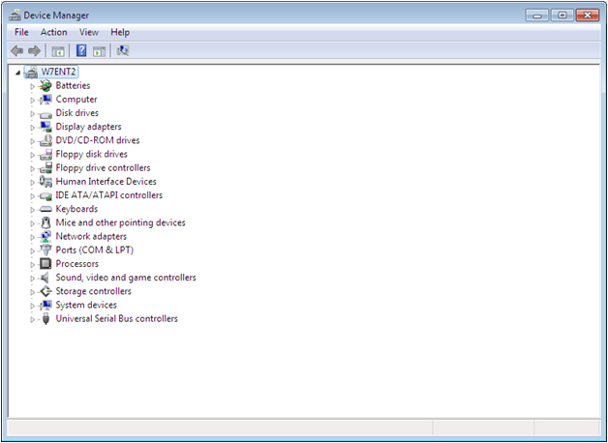
Device Manager
Notes:
Use the screen shot to describe what you see in the Device Manager if you cannot demonstrate.

Slide 37
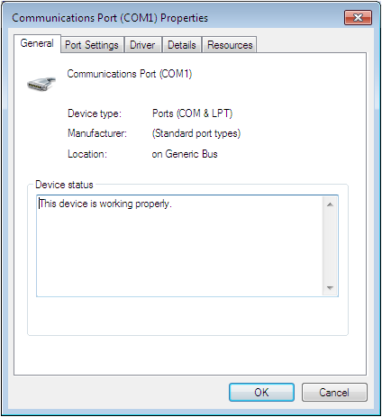
Viewing Device Properties
Notes:
Describe the information that can be found on each tab when viewing device properties. Use the screen shot on the slide if you cannot demonstrate.

Slide 38
Troubleshooting Drivers
Techniques for troubleshooting hardware or driver problems:
  Launch a troubleshooter from inside the Properties sheet of the device
  Delete the device in the Device Manager and restart to allow it to be detected again
  Use Safe Mode to load generic drivers to allow you into the system to troubleshoot
Notes:
Discuss the different methodologies of approaching a problem with hardware or drivers

Slide 39
Skills Summary
There are two hard disk partition styles that you can use in Windows 7: MBR and GPT.
Windows 7 supports two disk types: basic disks and dynamic disks.
Basic disks can have up to four partitions: three primary partitions and a fourth usually being an extended partition on which you can create multiple logical drives.
Windows 7 supports four types of dynamic volumes: simple, spanned, striped, and mirrored.

Slide 40
Skills Summary (cont.)
You use the Disk Management snap-in for MMC to manage disks.
The Virtual Hard Disk (VHD) format defines a file that contains the entire contents of a hard disk in a single, portable file that administrators can use to move entire virtual machines (VMs) from one host computer to another.
Native boot enables you to create and modify VHDs and even boot Windows 7 from a VHD, all without having to run Virtual PC or Hyper-V.

Slide 41
Skills Summary (cont.)
Device drivers are software components that applications and operating systems use to communicate with specific hardware devices.
Plug and Play is a standard that computers use to detect and identify hardware devices, and then install and configure drivers for those devices.
Using Device Manager, you can enable and disable devices, update and roll back drivers, and manage device and device driver properties.

